Slide 1
PaymentWalletApplication
-Batch 5

Slide 2
Team Members and Modules
Wallet Module – Bharath K.S , Preetham K
Customer Module – Preetham .K
BankAccount Module - N.S.Vishal , Mukesh kumar J
BillPayment Module – Soumya Ranjan Senapati
BenificiaryDetails Module – T.R. Sharath kumar
Transaction Module – Sathya Narayanan M , Mukesh kumar J
Guide:
Mr.RamanaReddy

Slide 3


https://github.com/MukeshkumarJPGAC/PaymentWalletApplication
https://teams.live.com/meet/95973031491131

Slide 4



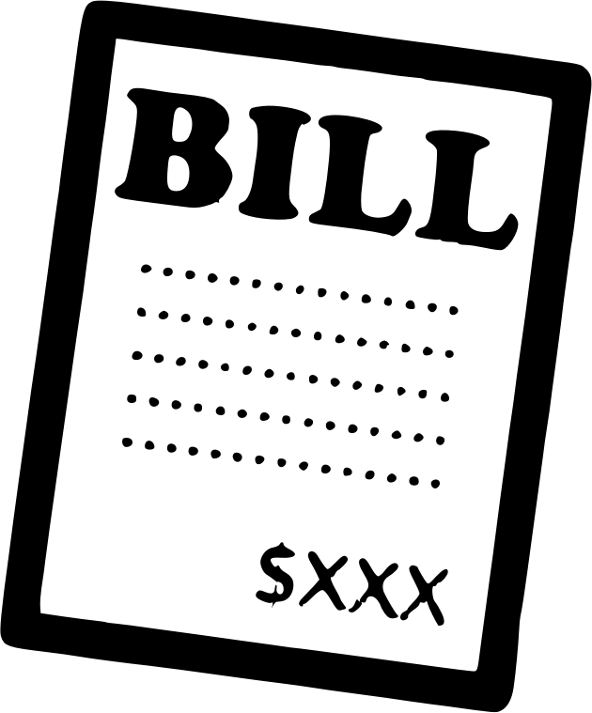


MODULES:
WALLET MODULE
CUSTOMER MODULE
BANKACCOUNT MODULE
BILLPAYMENT MODULE
TRANSACTION MODULE
BENEFICIARY MODULE

Slide 5
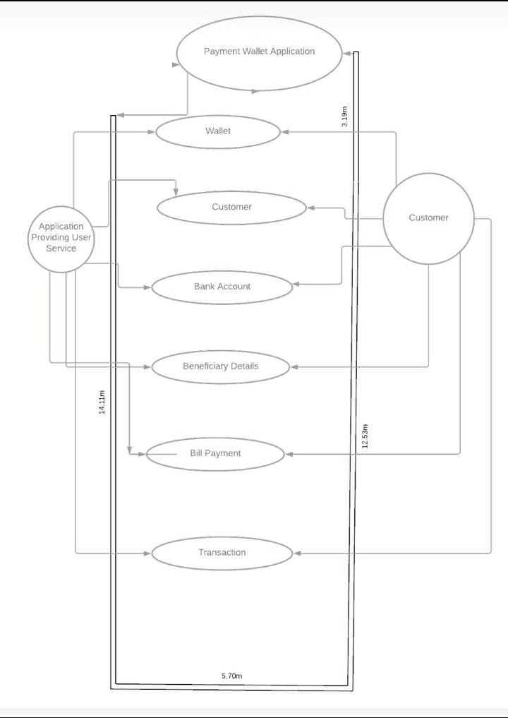
CASE DIAGRAM:

Slide 6
Class Design:
Wallet
-WalletId:int
-balance:BigDecimal
1
Customer
-name:String
-mobileNumber:String
-password:String
-wallet:Wallet
1
BeneficiaryDetails
-name:String
+mobile Number:String
1
1
1
1
1..*
0..*
BillPayment
0..*
-blind:int
-wallet:Wallet
-bill Type:Bill Type
-amount:double
-paymentDate:LocalDate
BankAccount
-accountNo:int
-ifscCode:String
-bankname:String
-balance:double
-wallet:Wallet
1..*
Transaction
-transactionId:int
-transactionType: String
-transactionDate:
-wallet:Wallet
-amount:double
-description:String

Slide 7
SERVICE INTERFACE:
IWalletService
public Customer createAccount(String name ,String mobileno, BigDecimal amount);
public BigDecimal showBalance (String mobileno);
public Customer fundTransfer (String sourceMobileNo,String targetMobileNo, BigDecimal amount);
public Customer withdrawAmount(String mobileNo, BigDecimal amount);
public List<Customer> getList();
public Customer updateAccount(Customer customer);
public Wallet addMoney(int walletid, double amount);
IAccountService
IUserService
public Wallet addAccount(BankAccount bacc);
public Wallet removeAccount(int bacc);
public Wallet viewAccount(int bacc);
public BankAccount viewBankAccount(int bacc);
public List<BankAccount> viewAllAccounts();
public Customer validateLoginUser(String mobileNumber,String password);
public List<Customer> getAllCustomer();
Customer addCustomerAccount(Customer customer);
IBillPaymentService
public BillPayment addBillPayment(BillPayment payment);
public BillPayment viewBillPayment(int paymentid);
public List<BenificiaryDetails> addBenificiary(BenificiaryDetails bd);
public List<BenificiaryDetails> updateBenificiary(BenificiaryDetails bd);
public String deleteBenificiary(int bd);
public BenificiaryDetails viewBenificiary(int bd);
public List<BenificiaryDetails> viewAllBenificiary(int w);
BenificiaryService
ITransactionService
public Transaction addTransaction(Transaction tran);
//public List<Transaction> viewAllTransactions(Wallet wallet)
public List<Transaction> viewTransactionsByDate(LocalDate from, LocalDate to);
public List<Transaction> viewAllTransactions(String type);
List<Transaction> viewAllTransactionsByWallet(int wid);
String deleteTransaction(int tid);

